Slide 1
Evaluation of Longitudinal Data using Mixed Effects Models
2006 Biostatistics lecture 3
John Kornak, PhD
John.kornak@ucsf.edu
Assistant Professor in Residence
Departments of Radiology, and Epidemiology and Biostatistics

Slide 2
Outline
Motivation
Clustered/Repeated data
Random and mixed effects models
Longitudinal data
Marginal “GEE” models
Binary models
Time series conditional models
A summary of modeling options

Slide 3
Motivation
Radiological studies are using longitudinal / repeated measures designs more and more often
Changes over time often have increased sensitivity (and specificity) to disease than a single snap-shot
Statistical methods tailored to repeated measurements will maximize the benefit of repeated measure data

Slide 4
Motivating example
Consider a (simulated) dataset consisting of Proximal bone mass density (P-BMD) measurements for a random population of 30 subjects:

Slide 5
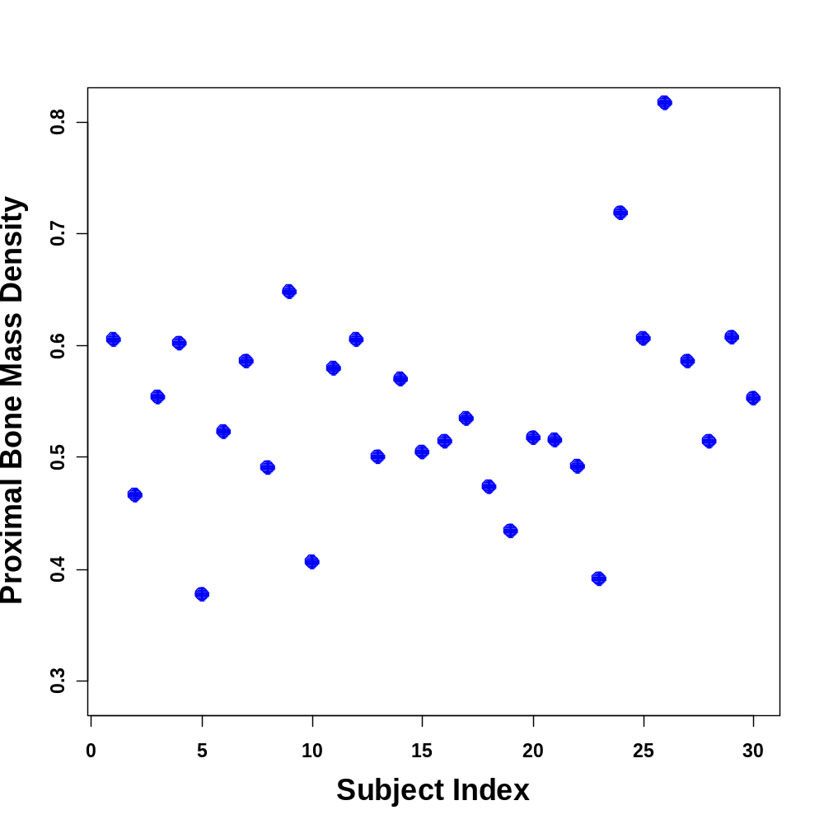
Single Observations

Slide 6
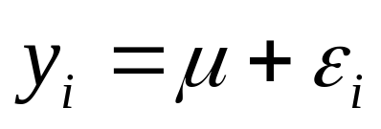

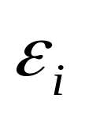
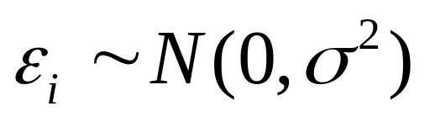
Consider the following model:
y_{i} is P-BMD and is the error term for subject i, where
This is a simple linear model and works well for the data described... (at least you can’t do any better)

Slide 7
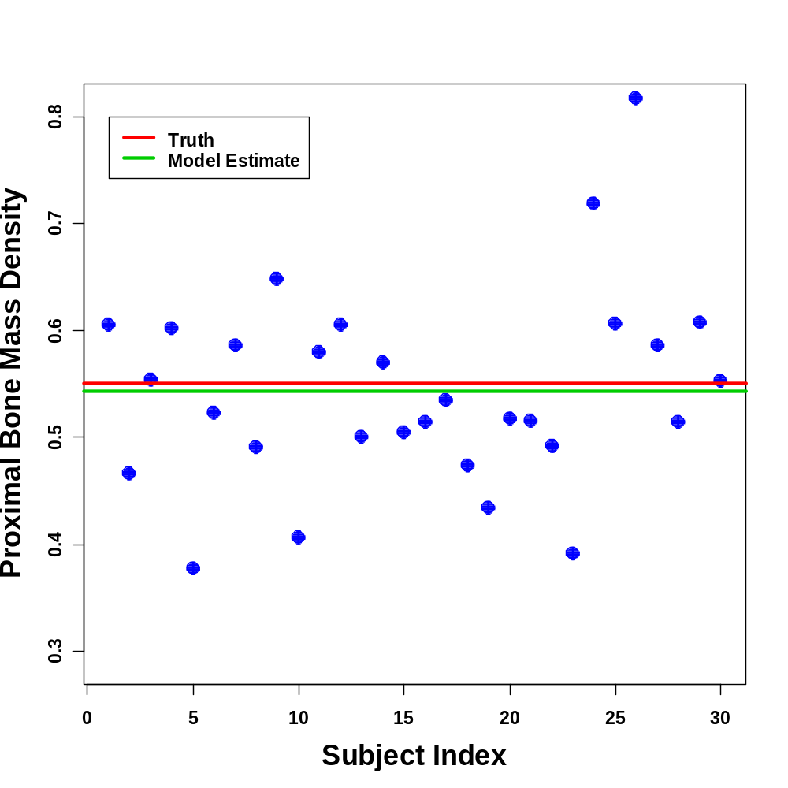
Model Fit

Slide 8
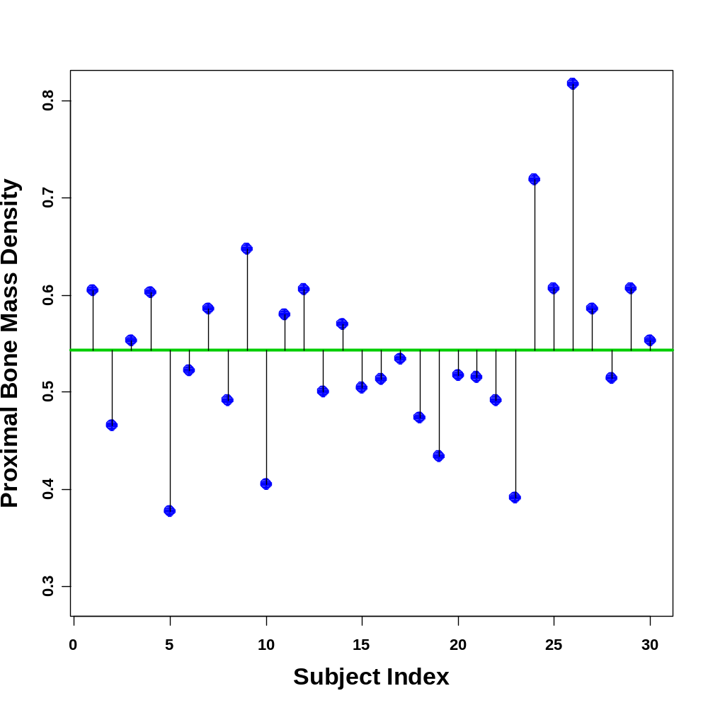
Model Fit

Slide 9
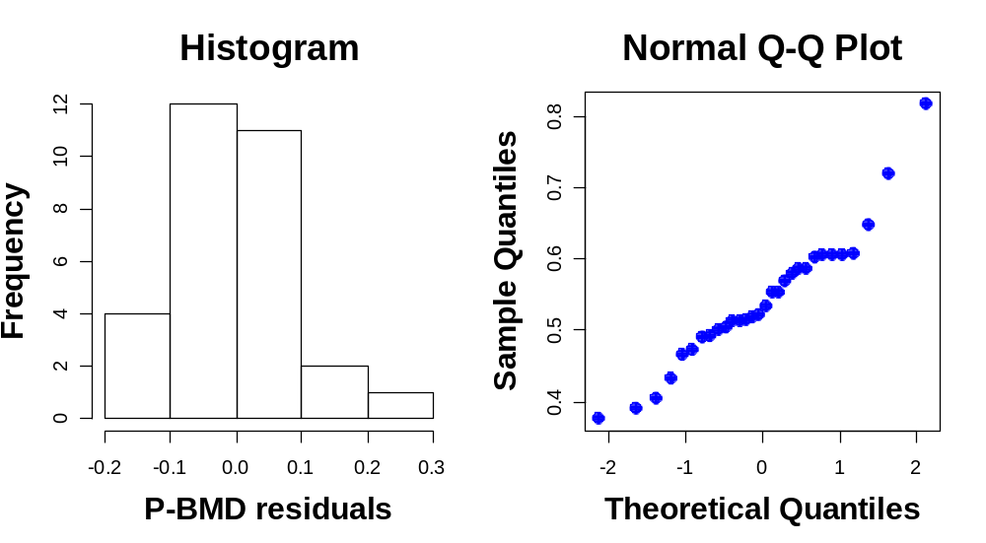
Model Fit

Slide 10
However, what if more than one measure is taken on each subject?
e.g. 3 measures for each of 10 subjects (clustered or panel data).
We still have 30 observations but...

Slide 11
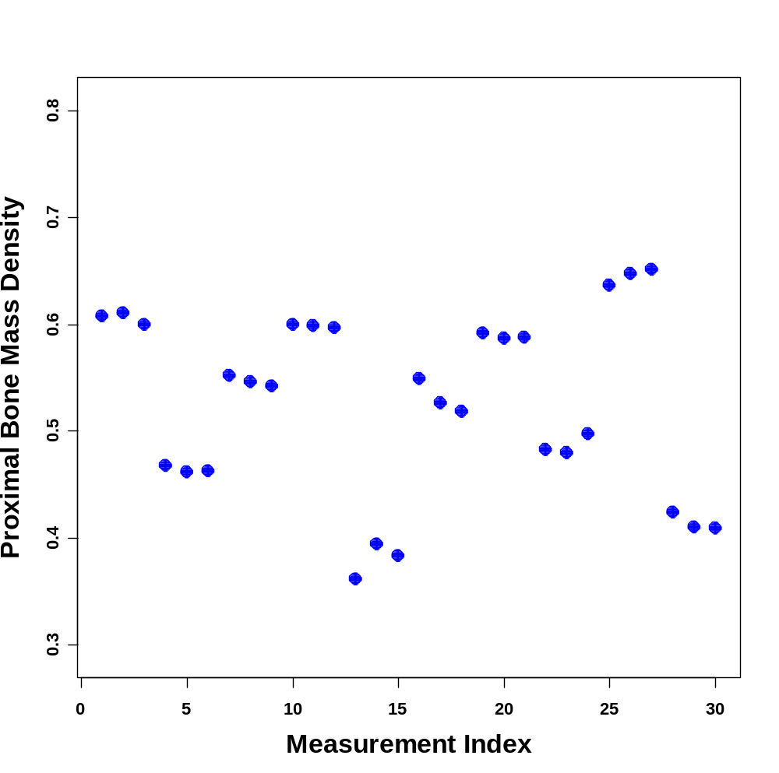
Clustered Data

Slide 12
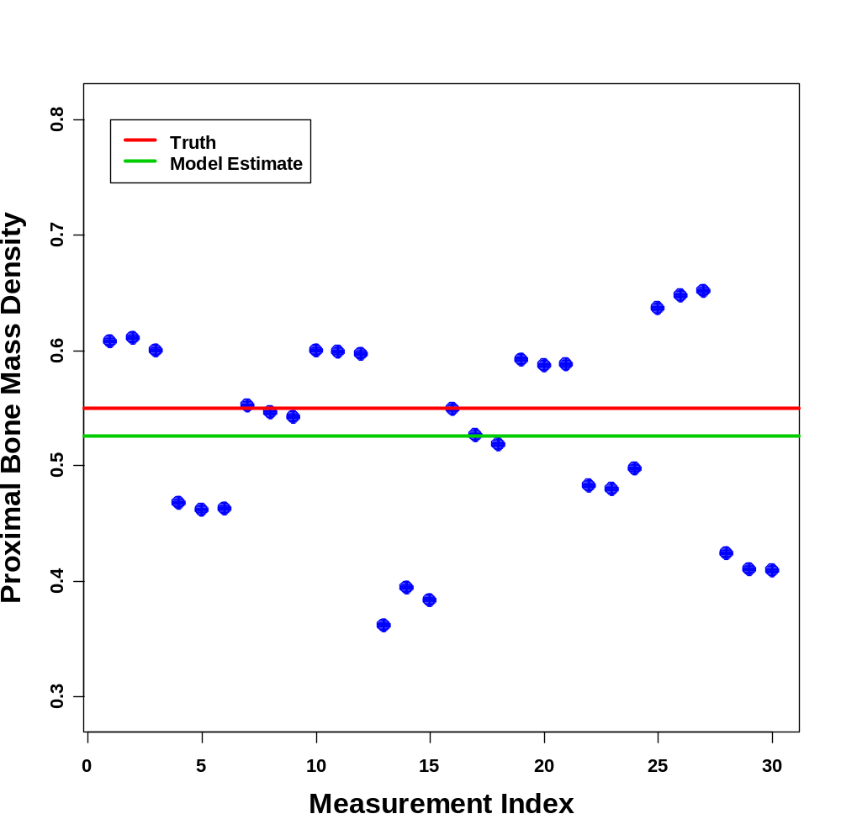
Model Fit

Slide 13
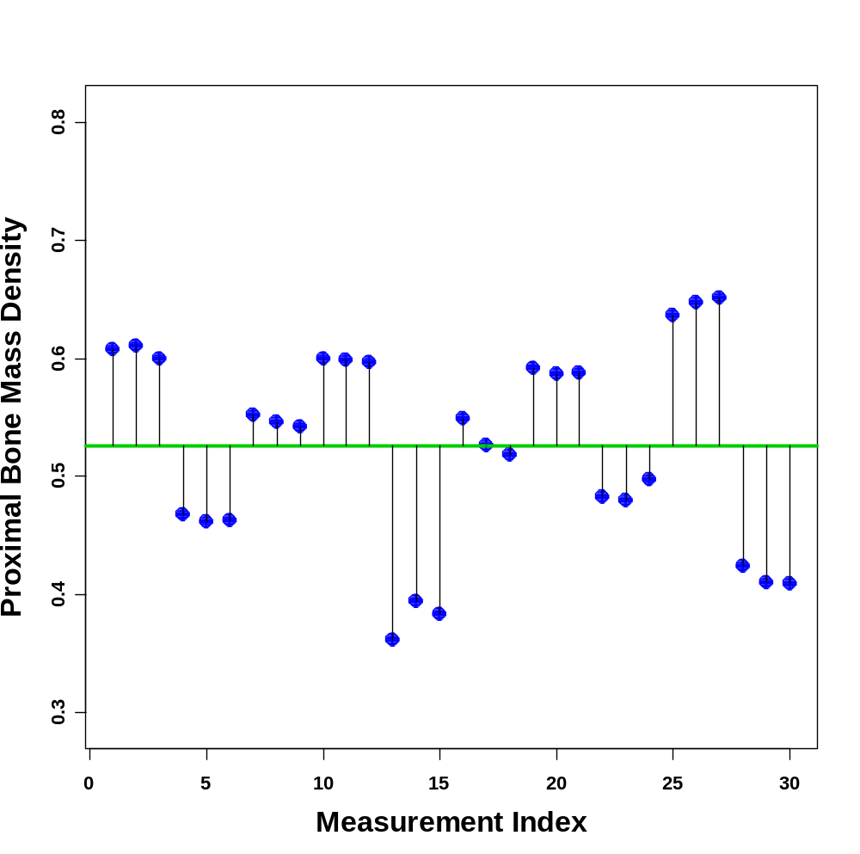
Model Fit
Subject 1
Subject 2

Slide 14
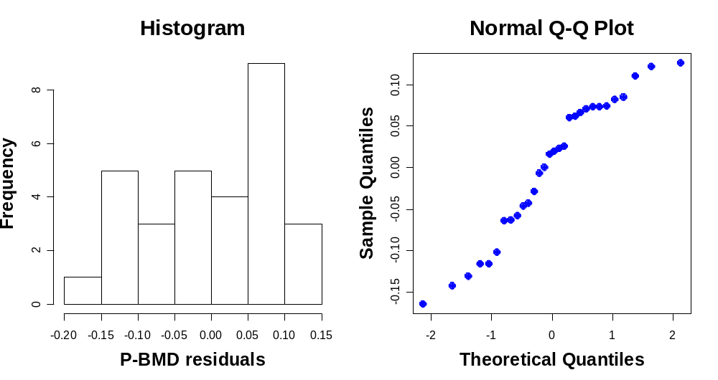
Model Fit

Slide 15
Clustered/Repeated data
Clustered response data occur for repeated measurements on individuals.
Repeated measurements for an individual are more likely to be similar than measurements from different individuals (correlated).
E.g., Repeated measurements of bone density on a single subject are likely to be quite similar (provided there is no drastic change in condition). Whereas measurements from one subject to the next can be very different.

Slide 16
Main Issue
Between Subject Variability
V
Within Subject Variability
2 variance components
Observations on different subjects - both between and within variability
Repeated observations on single subject – only within subject variability

Slide 17
Mixed-Effects Models

Slide 18
Improved Model for P-BMD
Assume subjects that are well matched, i.e. same gender, similar ages, etc.
Assume P-BMD for each subject randomly sampled from a “population” that is Gaussian (Normal)
Noise/variability on each observation assumed to come from a Gaussian distribution.

Slide 19
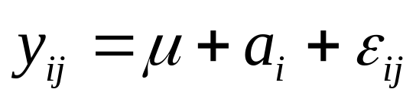
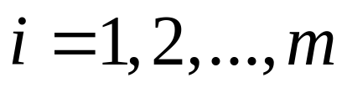
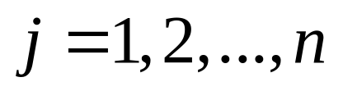
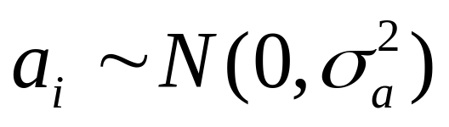

Mixed-effects Model for Proximal Bone Mass Density
i indexes the subjects and j indexes the set of observations on each subject.
a_{i} is the difference between subject i’s mean level and the overall mean of the population .
The mean level is a fixed effect whereas the a_{i} subject differences from the mean are random effects (modeled as Gaussian/Normal).

Slide 20
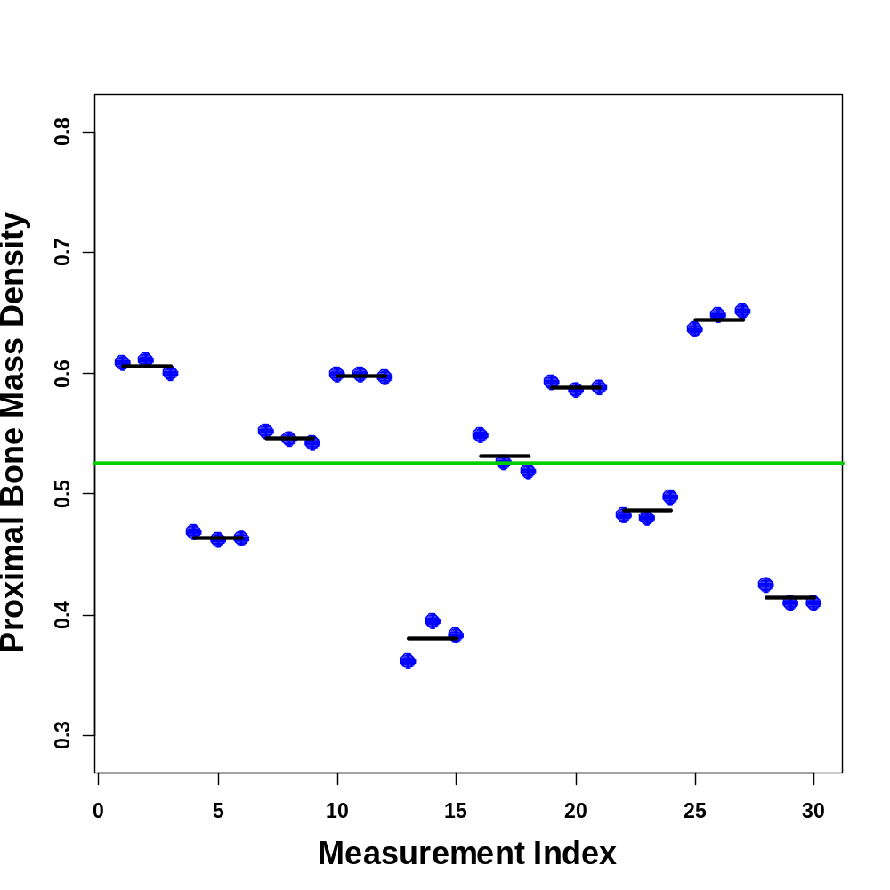
Mixed Model Fit

Slide 21
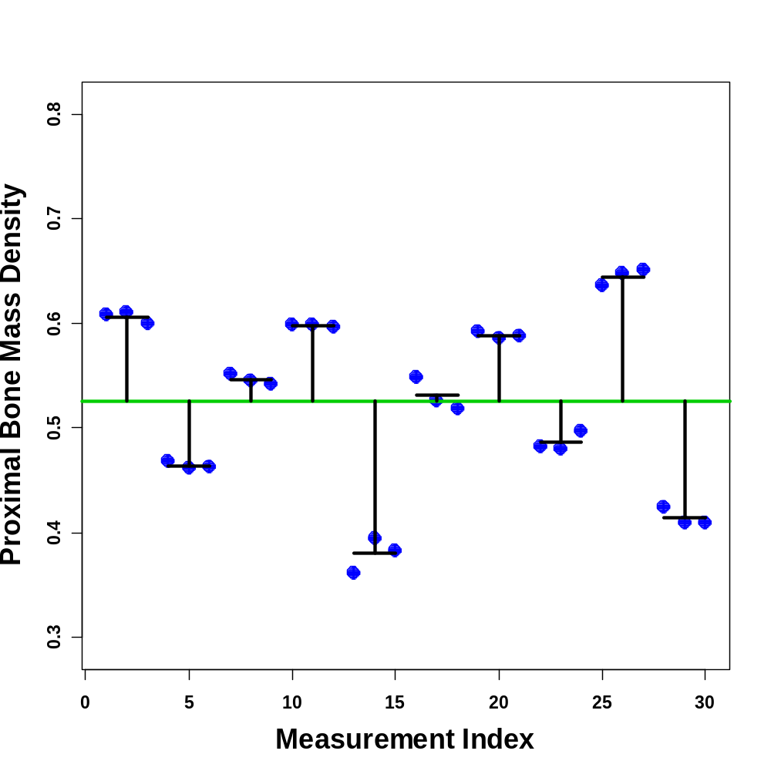
Mixed Model Fit

Slide 22
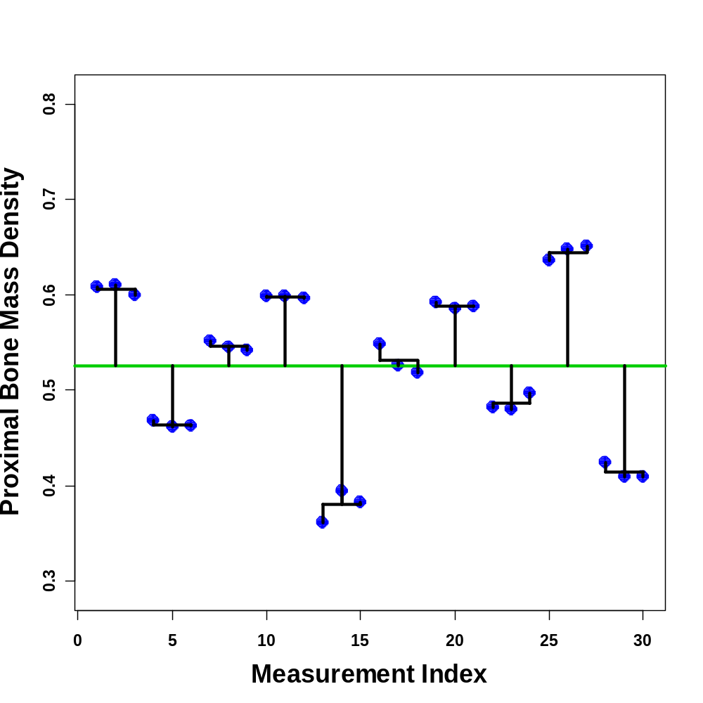
Mixed Model Fit

Slide 23
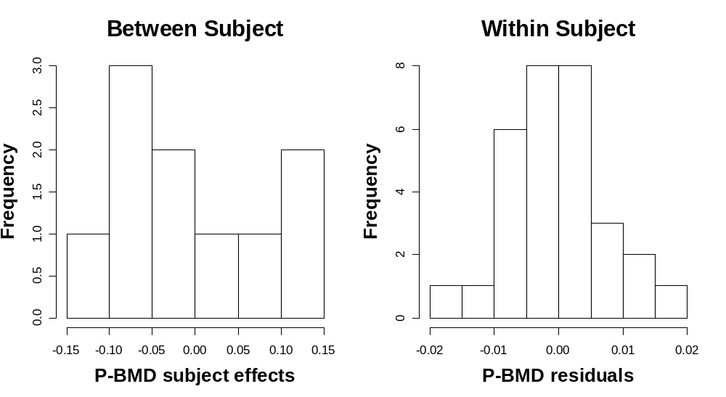
Mixed Model Fit

Slide 24
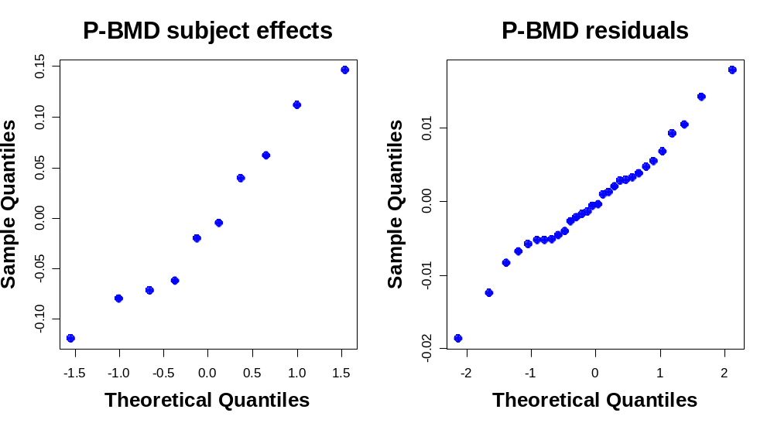
Mixed Model Fit

Slide 25
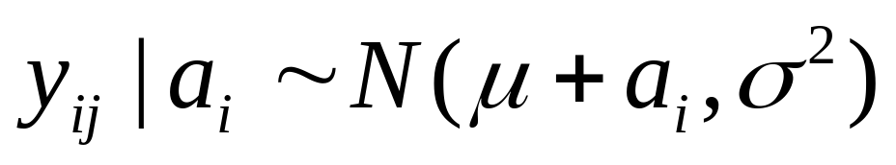
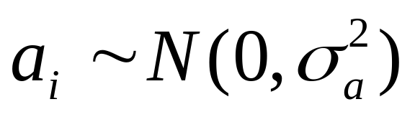
Mixed Effects Models
Mixed effects models are defined as models that have both fixed and random effects.
These models are also referred to as hierarchical or multilevel models because the modeling is performed at more than one level:

Slide 26
Fixed or Random?
Fixed effects are associated with an entire population
Random effects are employed for more than one observation on each experimental unit (usually subject)
The decision is not always obvious!
Important Question: “Can the levels of the factor be considered as having been generated by a probability distribution?”
YES: consider as random
NO: consider as fixed

Slide 27
Why do we care?
What happens if correlation is ignored?
Inferences on parameters will be wrong and imprecise.
Basically, we are ignoring information about how the data are likely to be grouped within individuals.
Improved power – detecting group differences

Slide 28
Longitudinal data
Defined by repeated observations on individuals
over time.
Readily permit the study of change in response
over time.
Repeated measurements, but time is allowed to
lapse between measurements.
Subject data correlated (over time).
Contrast with cross-sectional data where the
responses are not correlated (i.e. only depend on the explanatory variables / covariates).

Slide 29
Example: cortical loss in AD patients
Consider comparing the longitudinal effects on cortical gray matter volume between normal controls and newly diagnosed Alzheimer’s patients.

Slide 30
Longitudinal Mixed Effects Model
GM volume
NC
AD
time

Slide 31
Longitudinal Mixed Effects Model
GM volume
NC
AD
time

Slide 32
Longitudinal Mixed Effects Model
GM volume
NC
AD
time

Slide 33
Longitudinal Mixed Effects Model
GM volume
NC
AD
time

Slide 34
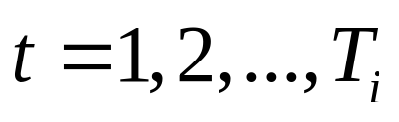
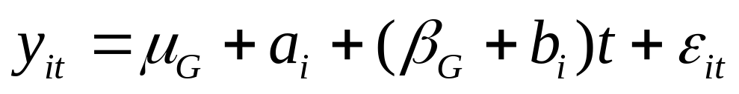
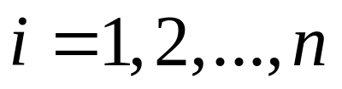
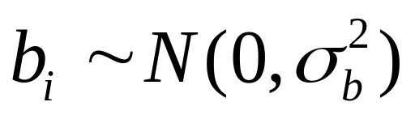
Proposed model:
G=1 for controls and 2 for AD patients
Index the repeated measures by t to indicate that these are repeated measures over time (longitudinal) and we have group mean effects for the AD and control groups.
(we could also fit polynomial terms etc.)

Slide 35
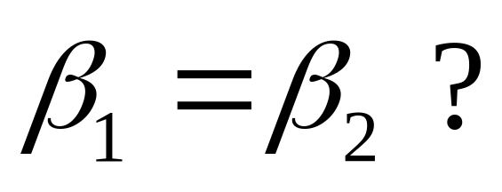
Question of interest:
Is there a difference in slopes (rates of change) between NC and AD?
Test whether

Slide 36
Longitudinal Mixed Effects Model
GM volume
NC
AD
time

Slide 37
Often in longitudinal MRI studies only 2 two measurements are taken on each subject, e.g. with 2 years between measurements. this is largely driven by 2 issues: 1, it takes a long while for noticeable changes in volume to occur and 2, scanner time is expensive.

Slide 38
Limitation of only 2 time points
GM volume
NC
Need to assume
parallel lines
AD
time

Slide 39
Limitation of only 2 time points
GM volume
NC
Need to assume
parallel lines
AD
time

Slide 40
Limitation of only 2 time points
GM volume
NC
Need to assume
parallel lines
AD
time

Slide 41
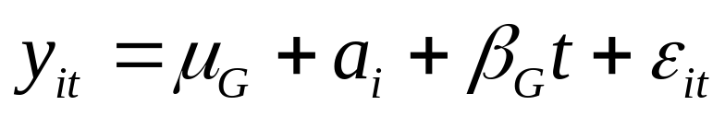
Simplified model for 2 timepoint data:
G=1 for controls and 2 for AD patients
We no longer consider the slopes in the model as random effects. We just have a fixed effect slope for each group.
Still require

Slide 42
Fitting mixed effects models
These models are fit by either maximum likelihood or restricted maximum likelihood (REML). Analytic solutions do not generally exist and iterative numerical optimization schemes need to be employed.
REML is often preferred over maximum likelihood for estimation because it gives unbiased estimates of the variance components.

Slide 43

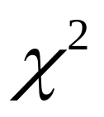
Hypothesis Testing
Hypothesis testing (e.g. ) not as easy as for linear model.
Likelihood ratio testing ok but problematic for small n’s
In that case consider conditional t- or conditional F- tests

Slide 44

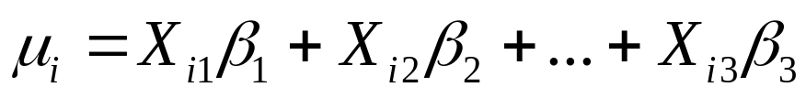
Many extensions to these example linear mixed effects model exist.
the mean can be modeled as a function of covariates i.e.
a correlation structure can be incorporated to model the relationship between more than one type of random effect... e.g. between subject slope and intercept
the residuals within an individual can be modeled as having some correlation structure.
Methods for fitting non-linear mixed effects models also exist but are not guaranteed to converge to a global maximum of the likelihood. Non-linear models are useful when a physical model of the temporal process exists (e.g. exponential decay). Reasonable starting estimates are usually required.

Slide 45
References:
Pinheiro and Bates – Mixed-Effects models in S-PLUS - Springer
McCullough and Searle – Generalized, Linear, and Mixed models - Wiley
Software:
S-plus and R – “lme” function for linear
mixed-effects and “nlme” for non-linear
mixed-effects - for R load library(nlme)
SAS – proc mixed

Slide 46
Marginal/GEE Models

Slide 47
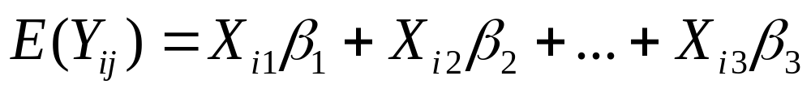
Model the expectation of Y_{ij} rather than the Y_{ij} directly
e.g.
A model for the correlation structure for observations within subjects also has to be defined.
There are many choices for the form of correlation structure that can be chosen
N.B. no explicit model for within subject errors

Slide 48
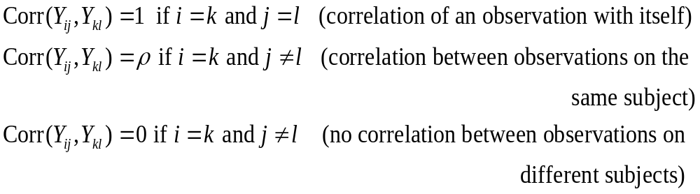
Consider earlier mixed effects grouped data model
Converting this to a marginal model:
Corresponding correlation structure is:

Slide 49
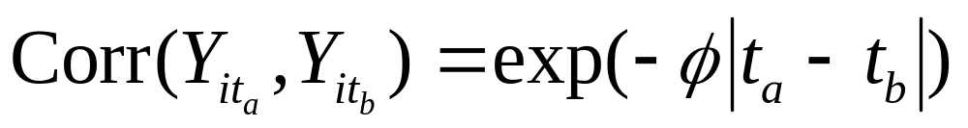

For longitudinal data we typically want the correlation to decay with increasing time lag
A common model is the exponential decay model:
controls the rate of decay in correlation. Larger values = faster decay.

Slide 50
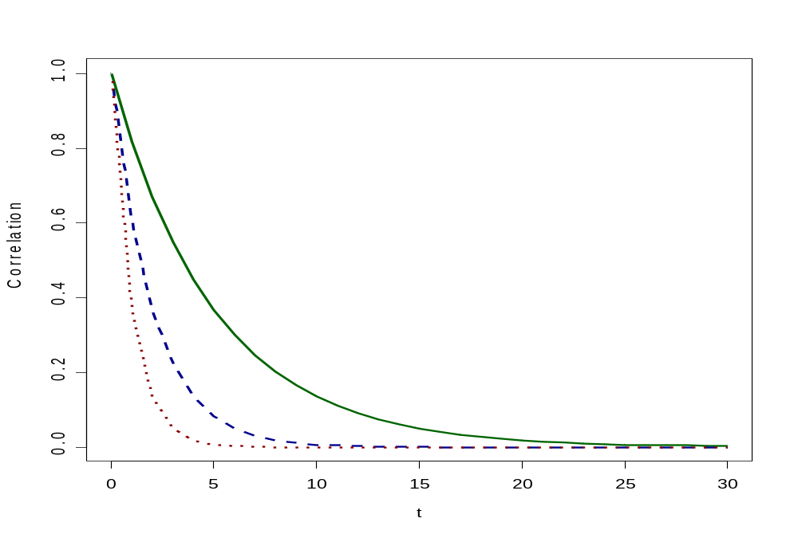




Slide 51
Fitting Marginal Models
In general, maximum likelihood estimation is not possible for marginal models.
Estimating equations are developed that have properties similar to equations derived for maximum likelihood estimation of simpler models. These are known as “Generalized Estimating Equations”.

Slide 52
Extensions: marginal models can also be extended in many ways. In particular, there is the capability to deal with binary data.
References:
Analysis of Longitudinal Data – Diggle et al.
- Oxford
Generalized Estimating Equations – Hardin
and Hilbe – Chapman & Hall
Software:
R – gee and geePACK library
SAS – PROC GENMOD

Slide 53
Mixed or Marginal Models?
Again, the choice is not clear cut!
Mixed models preferred for few observations on each subject compared to the number of subjects, and when interest lies primarily in modeling the trend in time.
Marginal models preferred when there are many observations for each each subject and when interest lies in modeling the correlation structure within subjects.

Slide 54
Trade
High efficiency (mixed effects model)
and
Robustness (marginal model)

Slide 55
Binary Data
Both mixed and marginal models exist
Generalized mixed effects models – incorporates logistic regression – tricky to fit
Binary marginal model – easier to fit (via GEE) and interpret

Slide 56
Time Series Style Models (Transition/Conditional Models)

Slide 57
Transition / Conditional Models
The idea for these models is to form the probability distribution for an observation at time t based on observations from times
t-1, t-2,..., t-p, where p is the lag of the process.
These models are typically used when we have long series of data on individuals that have equal spacings between time points.
There are 2 primary models of this type.

Slide 58
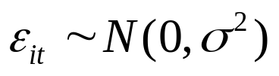
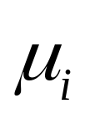
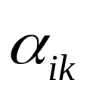
Autoregressive (AR) models
An AR(p) model takes the following form:
The response at time t depends on the overall mean for subject i, , and the deviations from the mean of the previous p observations (Markov model).
The terms determine the relative influence of previous terms relative to the overall mean.

Slide 59


Moving average (MA) models
An MA(q) model takes the following form:
The response at time t depends on the overall mean for subject i, , and the noise/variance terms from the previous p observations.
The terms determine the relative influence of previous noise terms relative to the overall mean

Slide 60
More on Transition Models
AR and MA processes can be fitted by maximum likelihood (choice of p and q is harder
A model with a mixture of AR and MA terms is called an ARMA model
A Binary model that depends on previous observations also exists. Example: if a subject is ill at the last time point it gives increased chance of being ill at a subsequent time point. Conditional likelihood estimation is required in this case

Slide 61
References:
Time series: a biostatistical introduction – Diggle,
Oxford University Press.
Modern Applied Statistics with S, 4th Ed. Ch. 14 –
Venables and Ripley, Springer.
Software: Venables and Ripley Ch. 14 describes the extensive tools available in R and Splus for these models.

Slide 62
Summary
Random and Mixed effects models – each subject’s mean is considered to come from some probability distribution. This implicitly provides a correlation structure to the observations
Marginal models – a model is formulated for the mean of the population. The correlation structure for individuals or groups is explicitly defined

Slide 63
Transition models – the mean for a subject at a particular timepoint is modeled as depending conditionally on past observations. This again implicitly implies a correlation between observations.
Spectral models – these models are useful for periodic data and consider the time-courses of data to be made up of a set of periodic (sinusoidal) patterns + variability.
Wavelet models – here the time course can be modeled as the sum of various basis functions + variability.

Slide 64
Next lecture:
Survival Analysis –
Tuesday, November 14, 2006 at NOON
Note: this is a changed time

